Slide 1
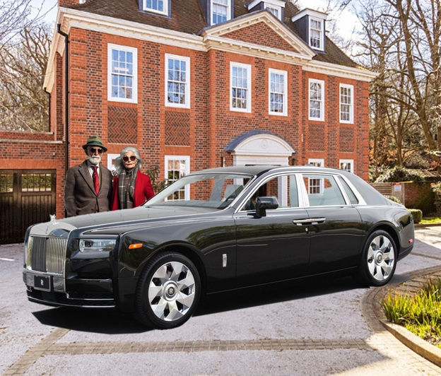
A Christmas Tale
Charles Godwin Aloysius MacFarlane Scrooge, a City investment broker, is the latest multi-millionaire in the Scrooge family dynasty, a long lineage of financially astute sociopaths with a proud history marred only by the tragic events of December 1843 when great-great-great grand-uncle Ebenezer shamefully betrayed the family ethos by falling victim to the
so-called spirit of Christmas, and was never forgiven. But that is another story.
Christmas 2025 now looms on the horizon, bringing the threat
of a renewed pestilence of seasonal choristers with their insufferably cheerful sentimental choruses and their cheap plastic begging bowls. Charles's normal response when encountering them was to drop a handful of steel washers into their collecting tin to create a convincingly coin-like rattle while he moved swiftly on. But that was not really a solution to this all-pervasive problem.
More decisive action would be required.

Slide 2
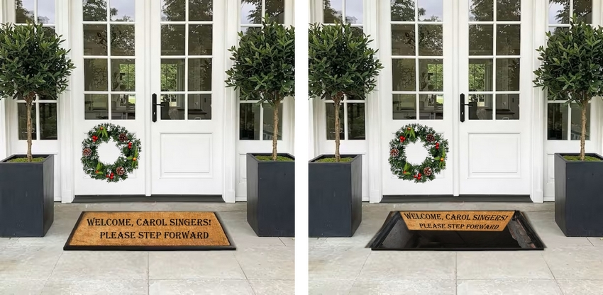
A small experimental trapdoor system outside the Scrooge's Chelsea townhouse had proved its deterrent value in tests involving door-to-door salesmen and charity callers.

Slide 3
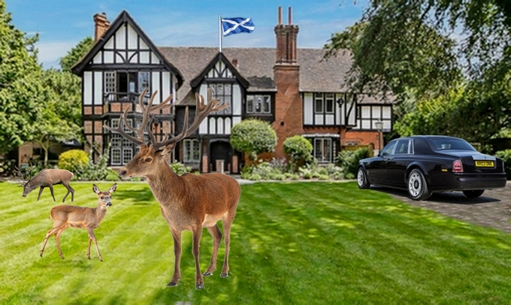
But Charles and his charming trophy wife Olga Rasputin-Scrooge were planning to spend the holiday break at Newgate Lodge, their palatial country house.
And that presented a problem.

Slide 4
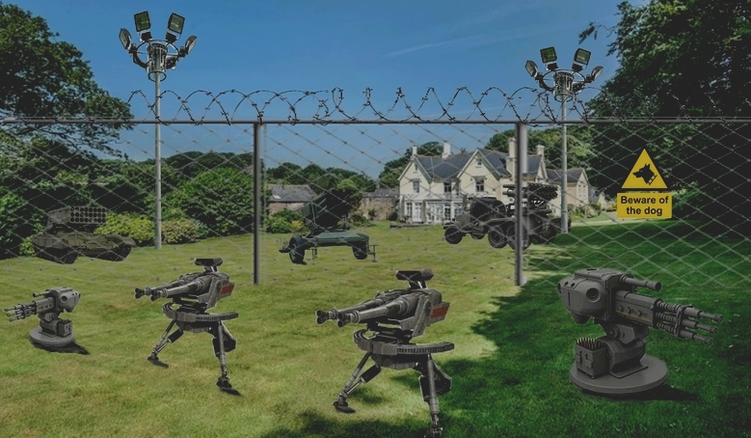
For the past two years the military-grade deterrence system at Newgate Lodge had been highly successful in reducing seasonal intrusions to an acceptable level.
However, following repeated complaints by local residents, the local authorities had ordered the entire security system to be dismantled on the grounds that "the overt threat implicit in the offensive weaponry on site may not be conducive to good community relations going forward."
Something more discreet, but equally effective, was called for. The Chelsea Experiment had given Charles an idea.

Slide 5
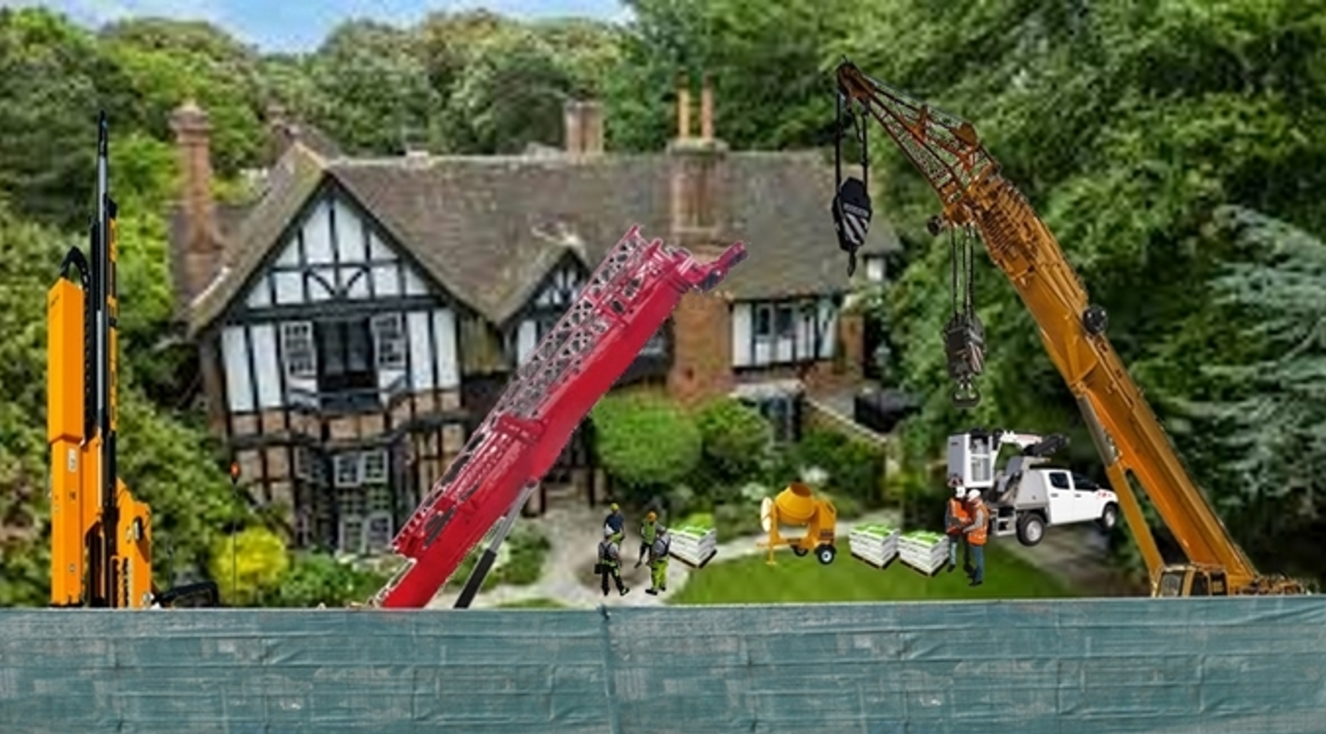


The precise nature and extent of the work undertaken in the grounds of Newgate Lodge between October and early December was carefully screened from public view . . .

Slide 6
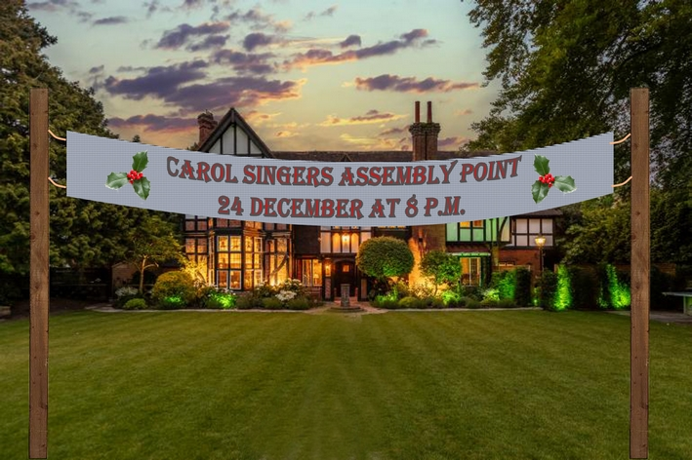
. . . but by mid-December, everything was in place. The scene was set, the bait was planted, and the
invitation was irresistible.`

Slide 7
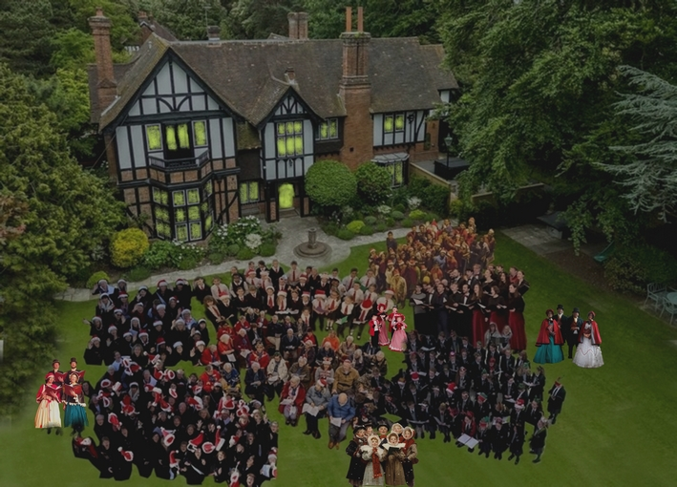
And sure enough, at the appointed hour, like moths to a flame, carol singers from far and wide converged on the front lawn of the Lodge, lured by the prospect of generous donations from a well-heeled local worthy

Slide 8
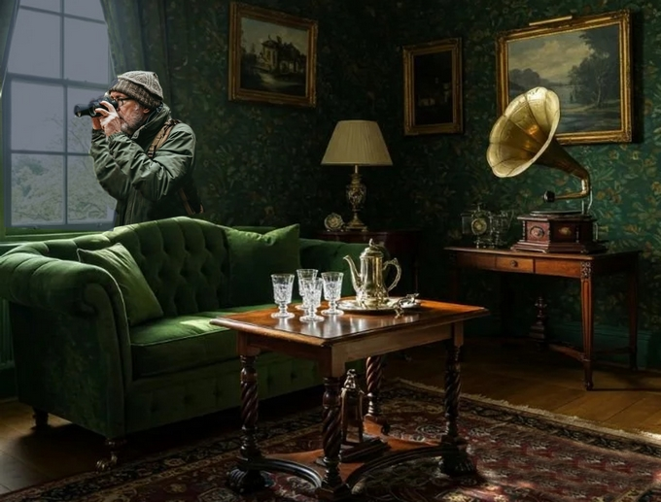
Meanwhile, the said local worthy was observing the growing throng with a keen tactical eye

Slide 9
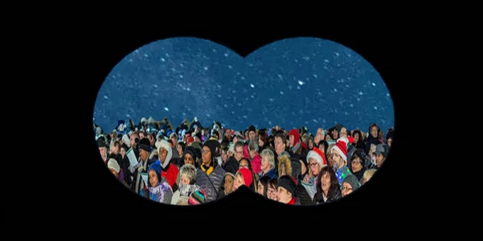
and when he judged the moment to be right . . .

Slide 10

. . . he reached over to his control panel and pressed the appropriate button to set things in motion

Slide 11
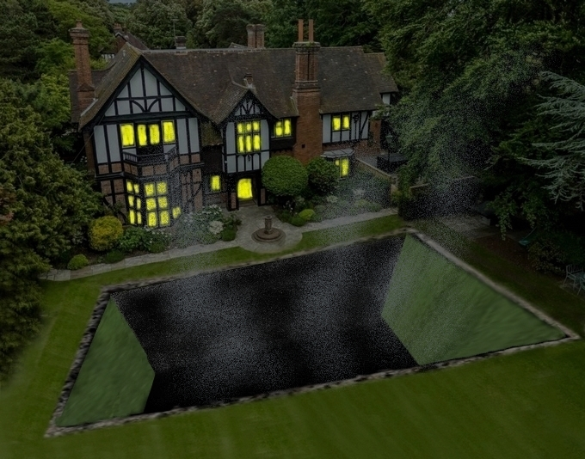
There was a titanic crash, a great cloud of dust and, at the very threshold of human perception, some faint sounds which might just have been indicative of alarm or distress.
This was followed by what could best be described as a deathly silence.

Slide 12
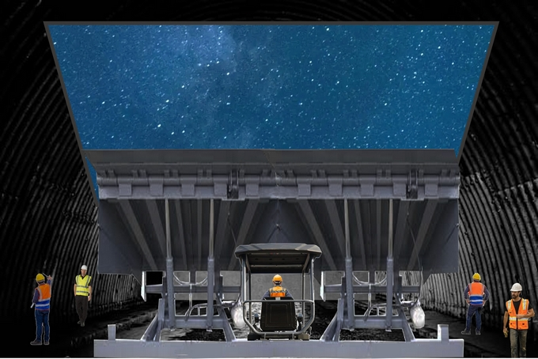
In underground bunkers at either side of the garden, gigantic hydraulic struts were set in motion to restore the Astroturf lawn segments to their horizontal closed position

Slide 13
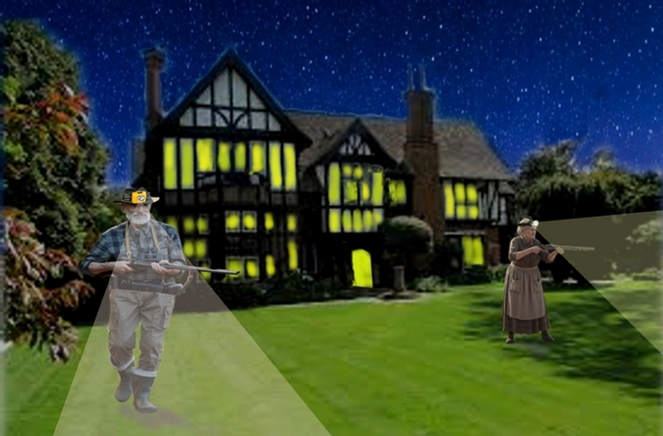
This enabled Charles and Olga to conduct a thorough sweep of the grounds to deal with any escapees . . .

Slide 14
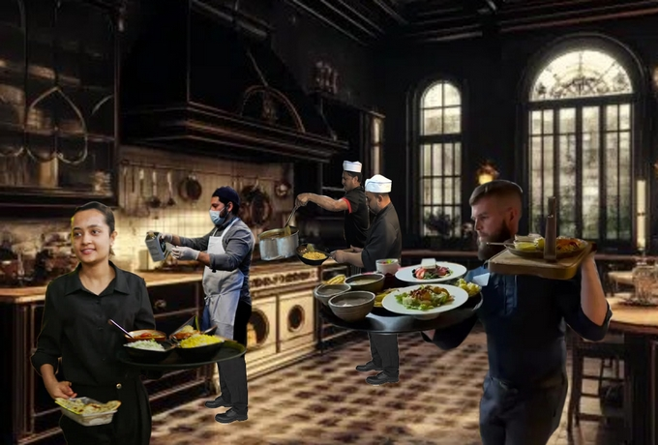
. . . before heading for the dining room where they enjoyed a hearty supper prepared and served
by their locally-recruited illegal immigrant house staff

Slide 15
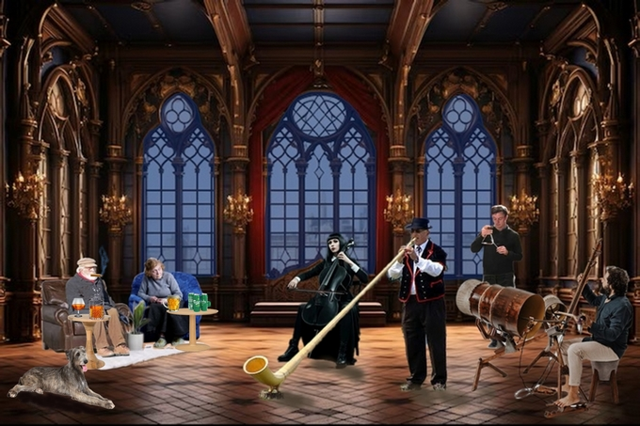
And having dined at leisure, they retired to the main reception lounge where they were entertained by a musical ensemble that was much more to their taste

Slide 16
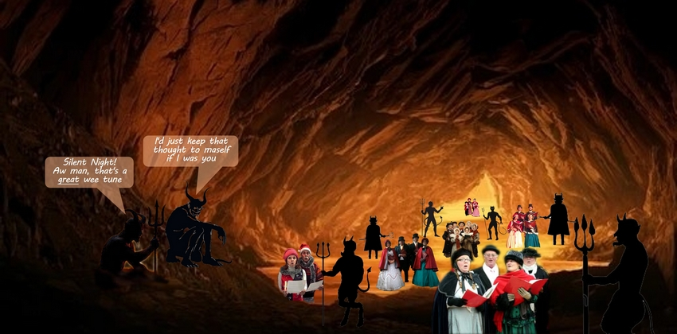
Meanwhile, somewhere far, far below, residential care staff were busy assessing and processing an unusual influx of new clients.
Some would quickly be assigned to permanent quarters in the immediate vicinity. Others - mainly those found in possession of banjos, autoharps or miniature xylophones - would be re-directed to secure accommodation facilities on the lower levels.

Slide 17
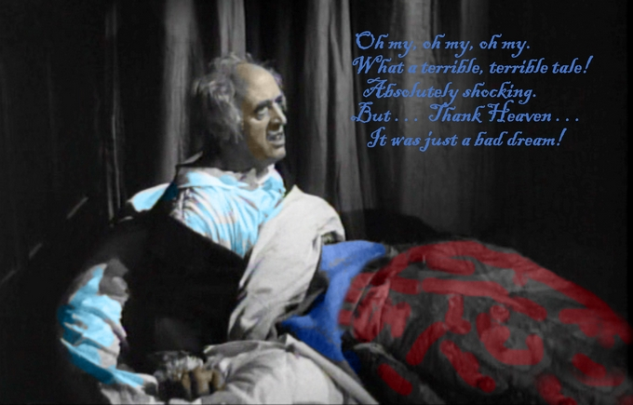

Slide 18





